Slide 1

Best practice forum:
marketing innovation
BEST PRACTICE FORUM:
MARKETING INNOVATION

Slide 2

YOU DON’T HAVE TO WAIT UNTIL YOU HAVE SOMETHING TO SAY…
TO SAY SOMETHING
Notes:
[Script: product and brand innovation is sporadic, but marketing is constant. Keeping top of mind outside of the usual brand and product innovation cycles is an art that is related to innovation.]

Slide 3
20%
63%
40%
HIGHER REVENUE WHEN PRIORITISING INNOVATION
OF HIGH GROWTH BRANDS SAY MARKETING IS ‘AGILE’
HIGHER CUSTOMER RETENTION WHEN INVESTING IN EXPERIENCE AND STORYTELLING

Slide 4
THE WORLD AROUND YOU CAN BE INSPIRATIONAL
Notes:
[Script: your brand may be static but the world isn’t - your brand’s relationship to the world is in flux. There is inspiration to be had from culture, society, your consumers and marketing/technological innovation]

Slide 5
01
USE EVENTS TO
TELL A NEW STORY

Slide 6
WHY DO THIS?
Uses top of mind awareness to your advantage
Can reposition the brand by playing off the event
Encourages quick creativity and responsiveness

Slide 7
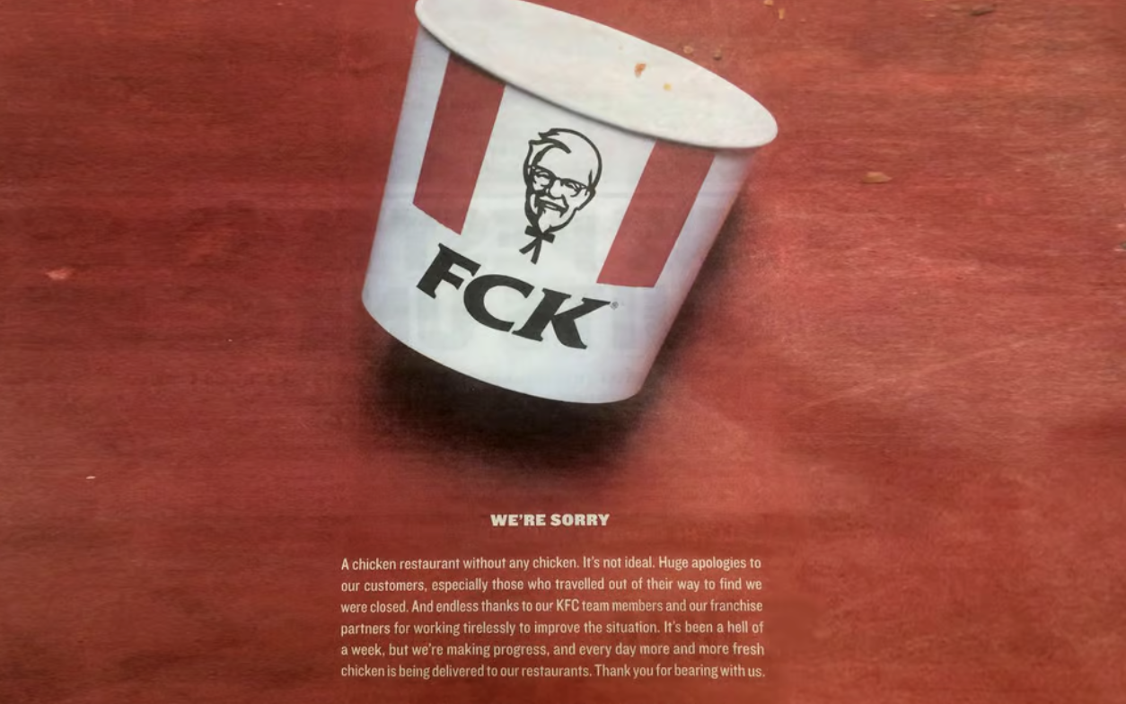
KFC:
FCK WE’RE SORRY
KFC issued this apology when they ran out of chicken, owning up to their mistake with a sly piece of wit.
KEY ELEMENTS
Quick reaction
Attuned to consumer sentiment
Use of humour cements brand love in eyes of the consumer
WATCH OUTS
Humour can misfire
Consumers can feel real frustrations are ignored
KFC: FCK WE’RE SORRY
KFC issued this apology when they ran out of chicken, owning up to their mistake with a sly piece of wit.
Key elements:
Quick reaction
Attuned to consumer sentiment
Use of humour cements brand love in eyes of the consumer
Watch outs:
Humour can misfire
Consumers can feel real frustrations are ignored
KFC issued this apology when they ran out of chicken, owning up to their mistake with a sly piece of wit.
KEY ELEMENTS
Quick reaction
Attuned to consumer sentiment
Use of humour cements brand love in eyes of the consumer
WATCH OUTS
Humour can misfire
Consumers can feel real frustrations are ignored
7

Slide 8
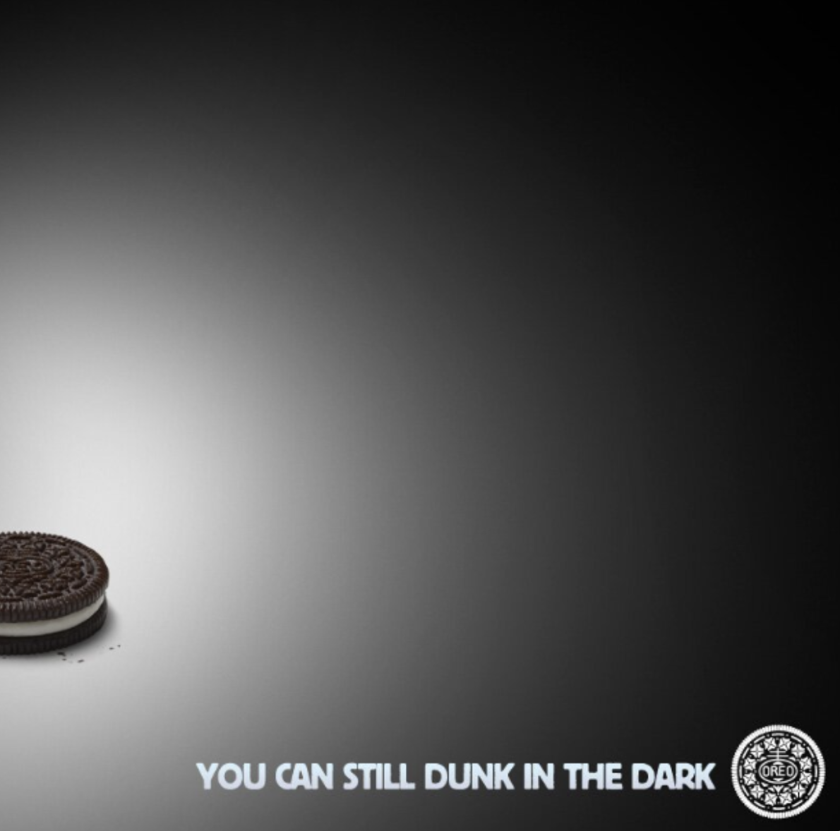
OREO:
YOU CAN STILL DUNK IN THE DARK
A tweet in response to a power outage during an important football match, delivered via social.
KEY ELEMENTS
Real-time turnaround
Use of cultural event
Restrained response
Use of humour
WATCH OUTS
Tone can be wrong
Can feel intrusive/desperate
Can be too late [conversation has moved on]
OREO: YOU CAN STILL DUNK IN THE DARK
A tweet in response to a power outage during an important football match, delivered via social.
Key elements:
Real-time turnaround
Use of cultural event
Restrained response
Use of humour
Watch outs:
Tone can be wrong
Can feel intrusive/desperate
Can be too late [conversation has moved on]

Slide 9
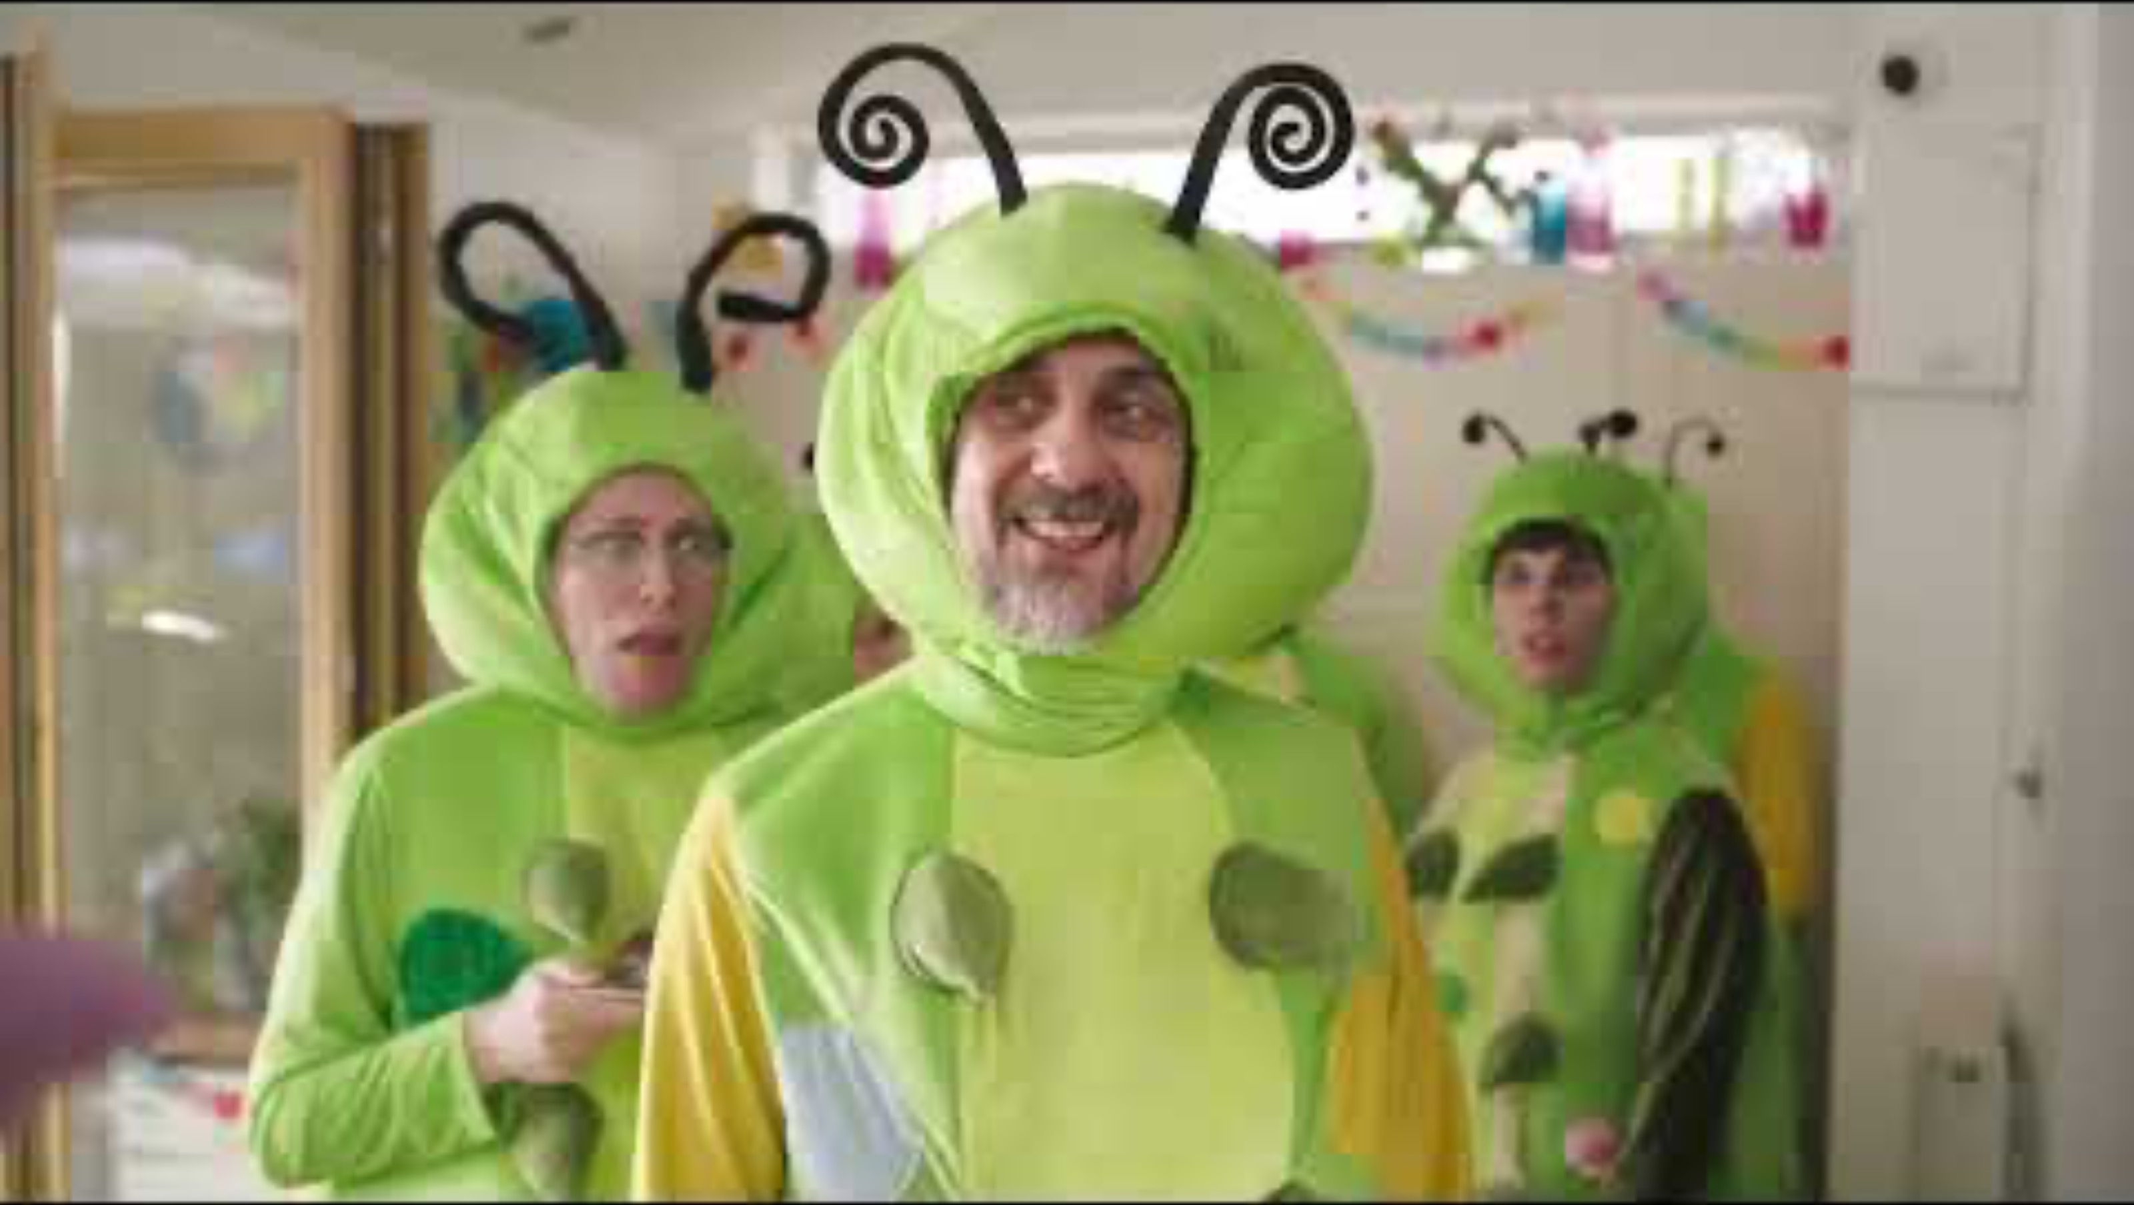
9

Slide 10
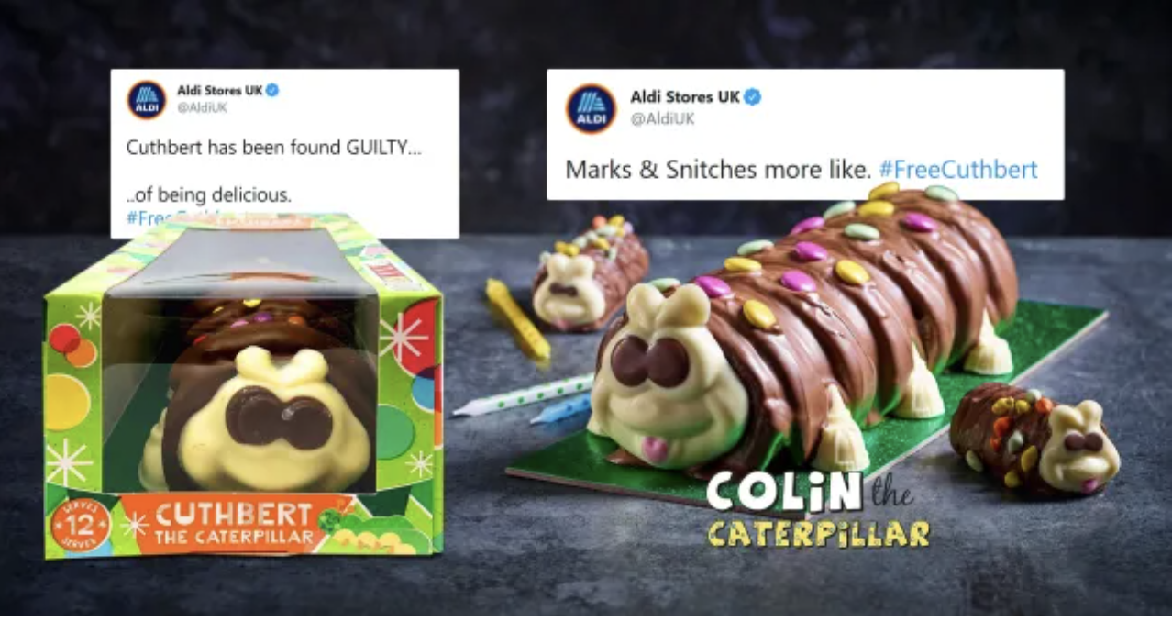
ALDI UK:
COLIN THE CATERPILLAR CAKE
Aldi reacted to their ongoing war with M&S by creating social content and ads making fun of the spat.
KEY ELEMENTS
Use of tabloid buzz
Bravery to poke gentle fun at a rival
Turned negative into a positive
WATCH OUTS
Legal repercussions
Misfiring of tone
Negative perception of brand
10

Slide 11
HOW CAN YOU DO THIS?
Spot opportunities outside of usual campaign cycle, the more local the better.
Keep your ear to the ground in terms of consumer attitudes towards the brand.
Plan for known events such as holidays, festivals, current affairs.

Slide 12
2.
FLIP THE SCRIPT
02
FLIP THE SCRIPT

Slide 13
WHY DO THIS?
Makes consumers
re-assess the brand
Opportunity for
disruption and creativity
Use of humour is built in

Slide 14
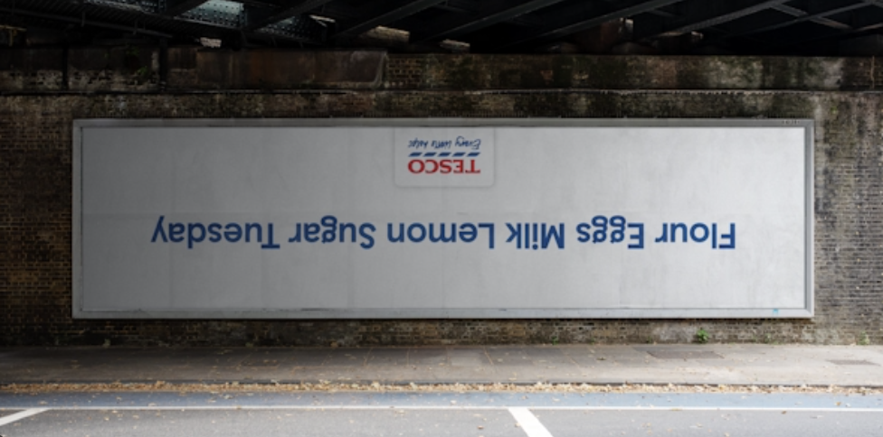
TESCO:
PANCAKE DAY
An OOH campaign for Pancake Day in the UK.
KEY ELEMENTS
Overturning of the norm
Simple execution
Cultural moment
WATCH OUTS
Mistiming
Misplacing
14

Slide 15
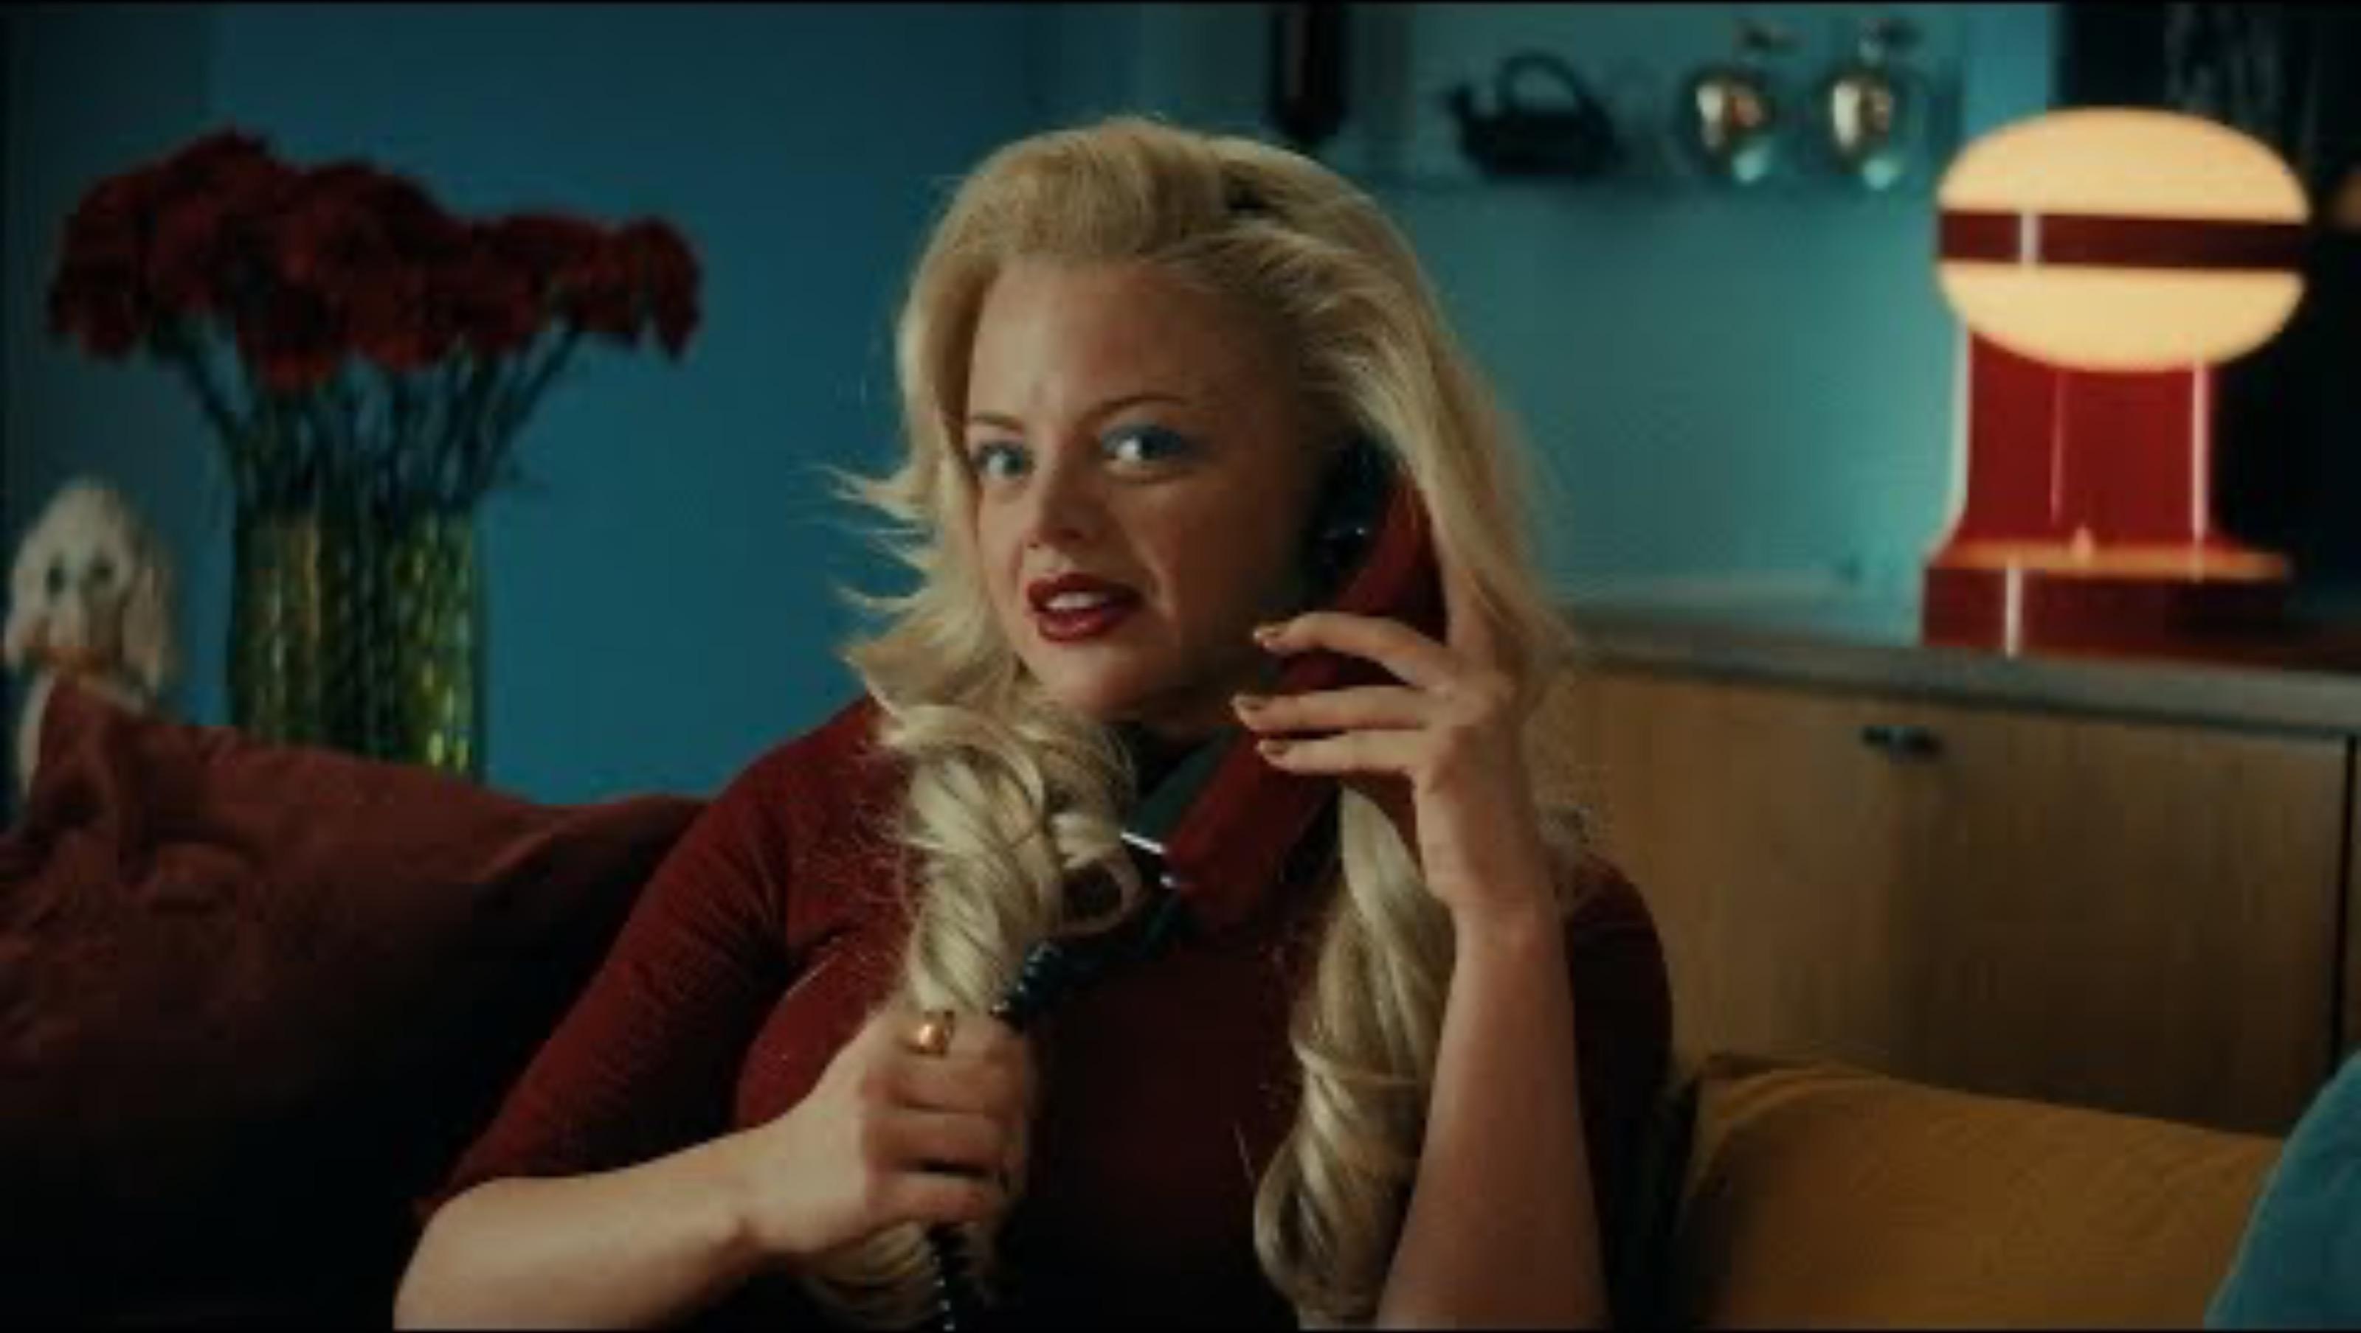
Lynx flipped their messaging from succeeding with women to succeeding with their cats
Key elements:
Flipping their existing advertising
PR-ability
Self-deprecation
Watch outs:
Misfiring of the messaging
Insulting one or more groups
Distracting from product RTBs
15

Slide 16
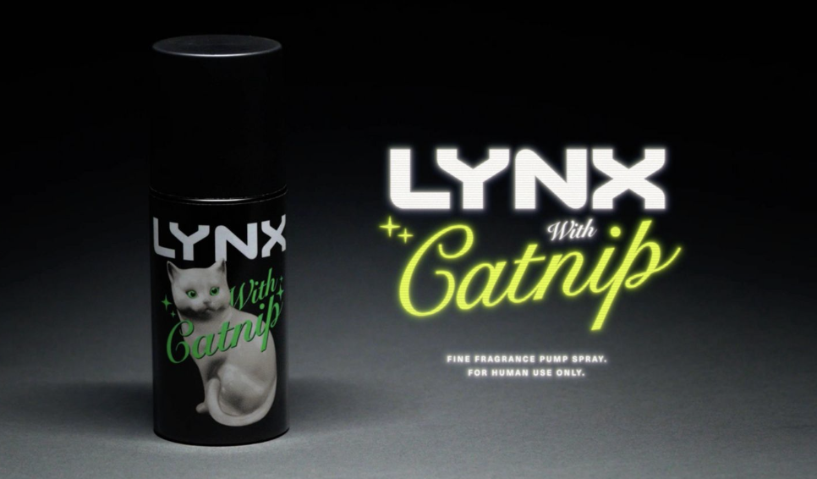
LYNX: CATNIP
Lynx flipped their messaging from succeeding with women to succeeding with their cats.
KEY ELEMENTS
Flipping their existing advertising
PR-ability
Self-deprecation
WATCH OUTS
Misfiring of the messaging
Insulting one or more groups
Distracting from product RTBs
Lynx flipped their messaging from succeeding with women to succeeding with their cats
Key elements:
Flipping their existing advertising
PR-ability
Self-deprecation
Watch outs:
Misfiring of the messaging
Insulting one or more groups
Distracting from product RTBs
16

Slide 17
HOW CAN YOU DO THIS?
Use consumer insight to subvert expectations
Ideate around upending conventions
Take inspiration from the world around you

Slide 18
03
CREATE SOMETHING NEW

Slide 19
WHY DO THIS?
Enriches the brand - you’re offering more consumer value
Shows you understand your audience
Opportunity for partnerships

Slide 20
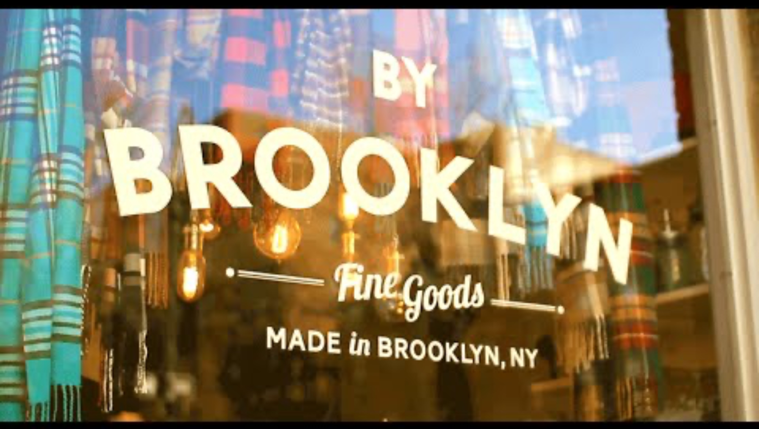
20

Slide 21
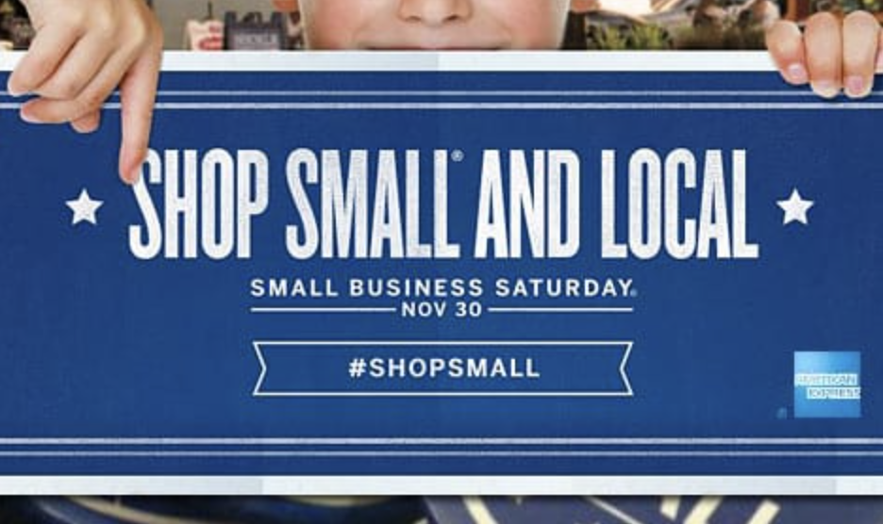
AMERICAN EXPRESS: SMALL BUSINESS SATURDAY
American Express created Small Business
Saturday to encourage shopping at small businesses.
KEY ELEMENTS
Based on consumer insight
Gives back to the community
Tangible benefit
WATCH OUTS
Empty gestures
PR vs consumer benefit
Lack of follow-through / longevity
21

Slide 22
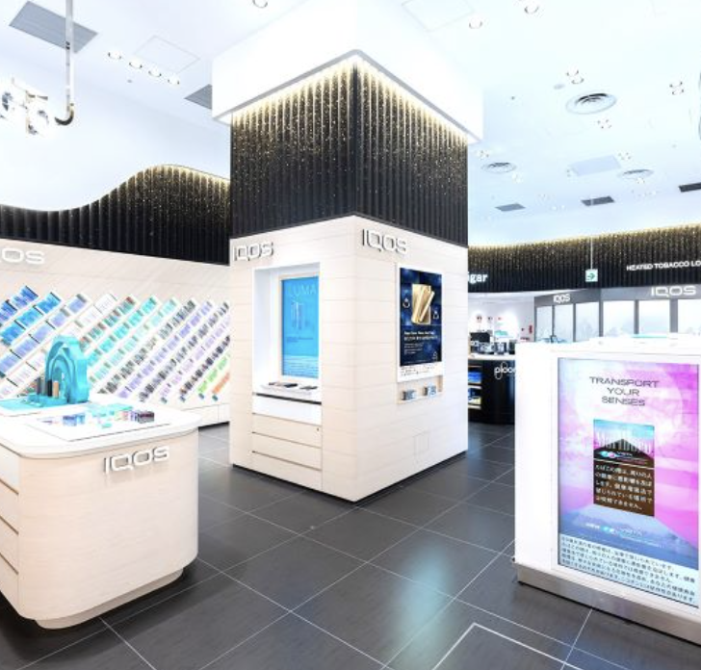
IQOS: WELLNESS SPACES
iQos created ‘wellness spaces’ in travel retail in the style of Apple Stores, in order to give consumers somewhere to relax and experience the product.
KEY ELEMENTS
Close tie to brand values
Links product with experience
Great for visibility
WATCH OUTS
Needs to live up to its promise
Could lead to criticism of associating ‘wellness’ with heated tobacco
22

Slide 23
HOW CAN YOU DO THIS?
Think about how your brand essence and RTBs can lead to a new experience
Think about what your consumer may want or need
Think about creating something with longevity

Slide 24
04
REINVENT EXPERIENCE

Slide 25
WHY DO THIS?
Helps you interact with consumers in new ways
Can capture new audiences in new spaces
Can demonstrate your relevance / innovation

Slide 26
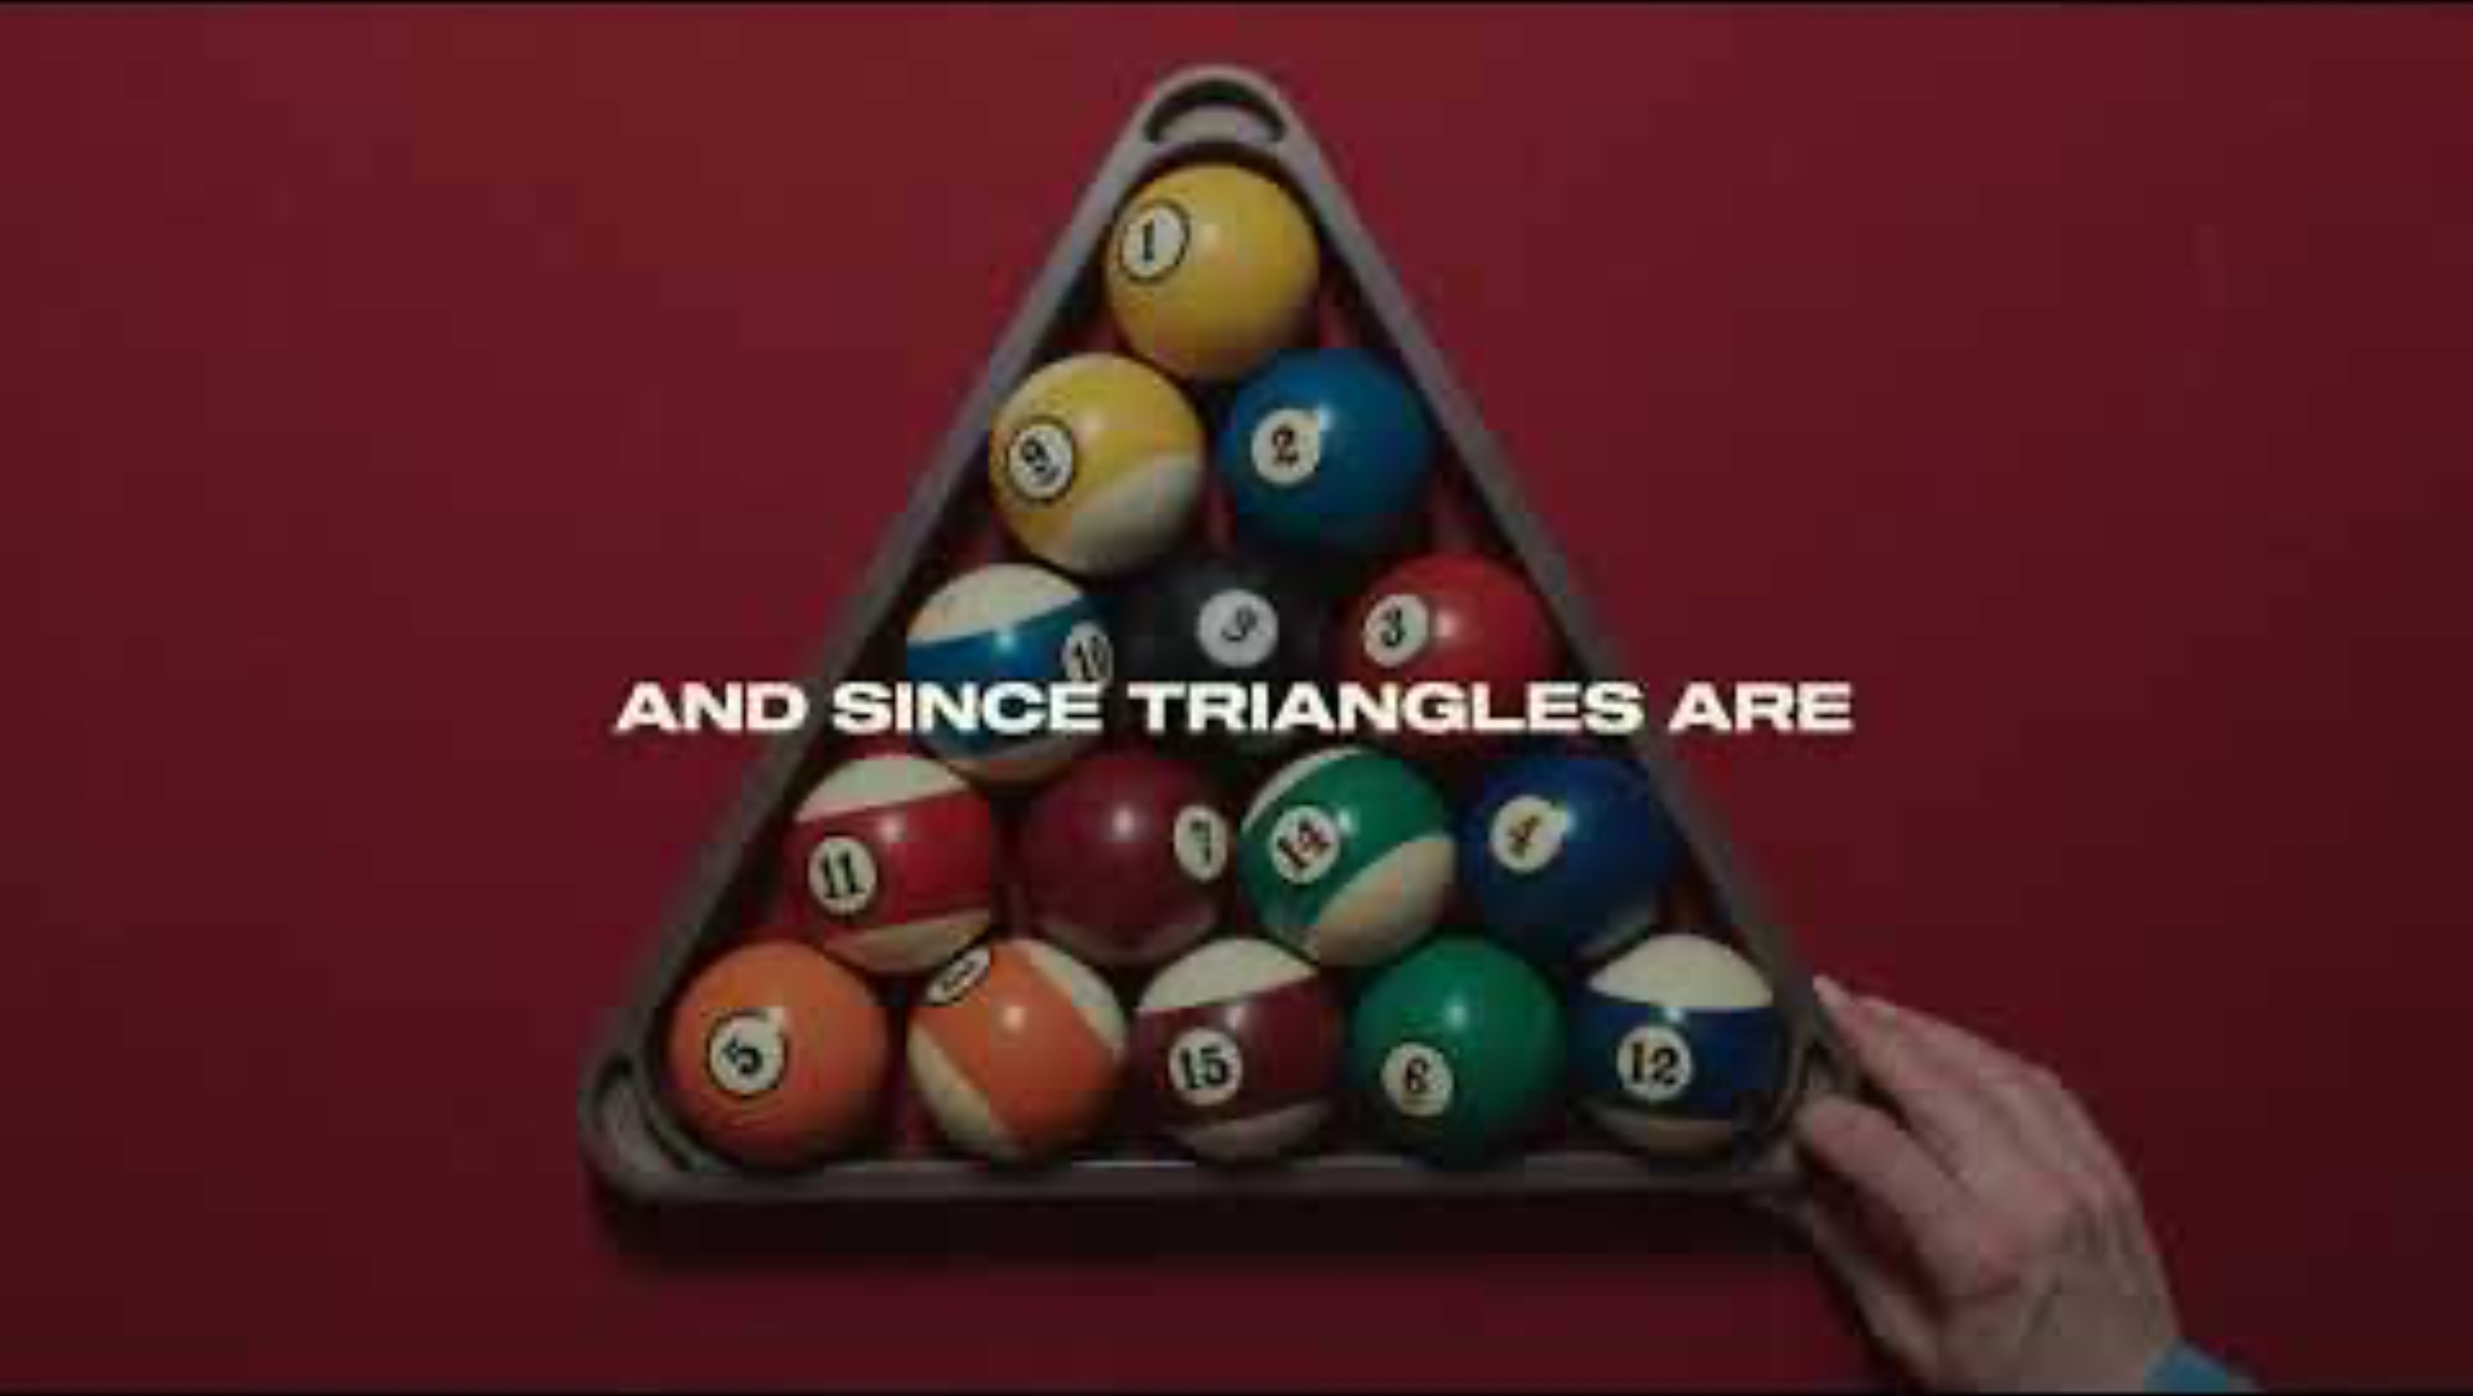
26

Slide 27
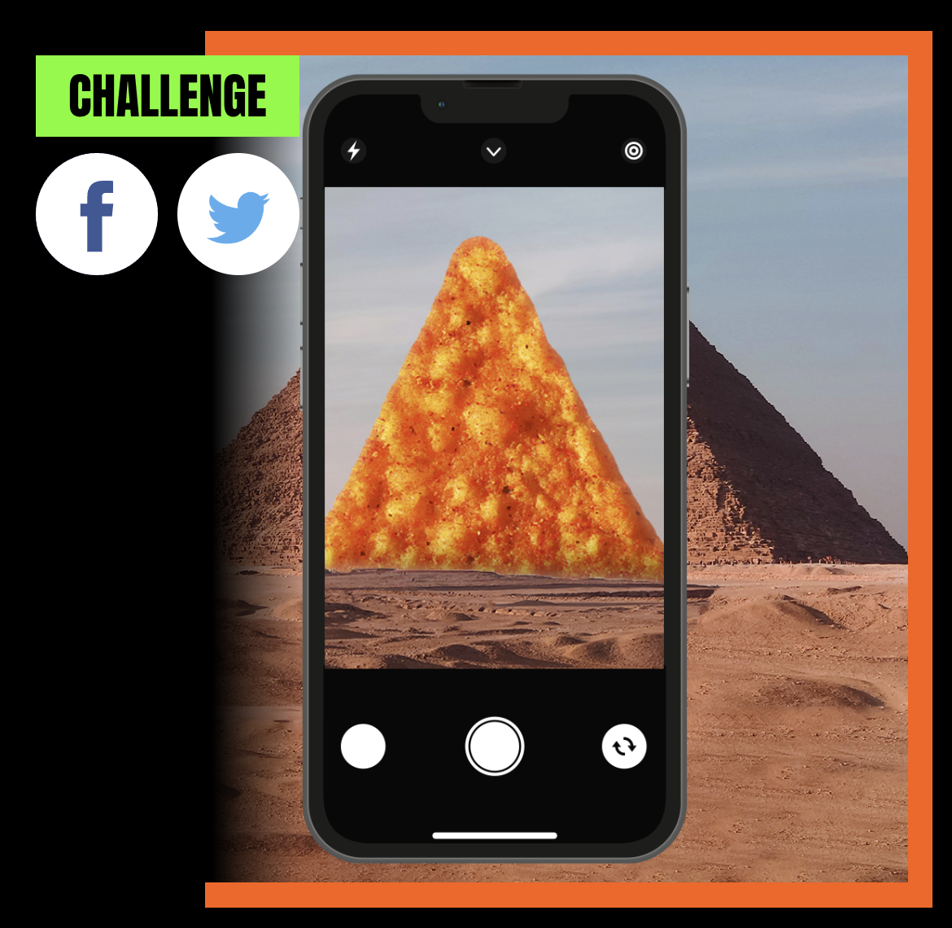
DORITOS: TRIANGLE TRACKER
Doritos used Snapchat AR lens to convert any triangle into challenges and rewards.
KEY ELEMENTS
Brand is front and centre
Builds excitement around activities
Rewards consumers
WATCH OUTS
Can be expensive to set up
Digital experience needs to be on point
27

Slide 28

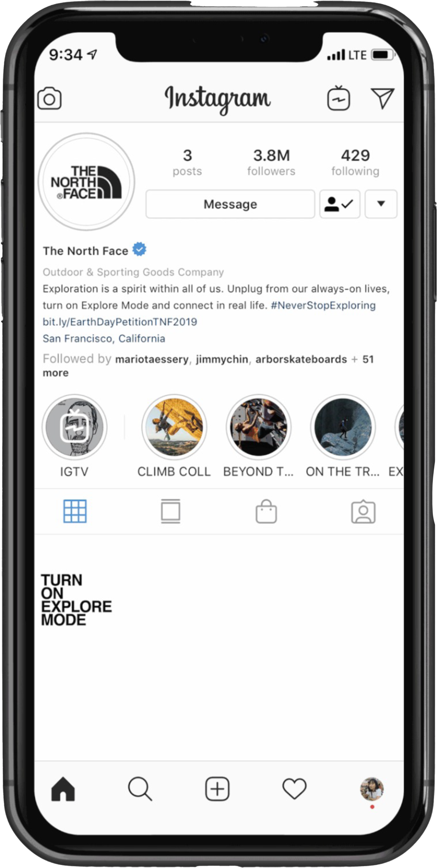
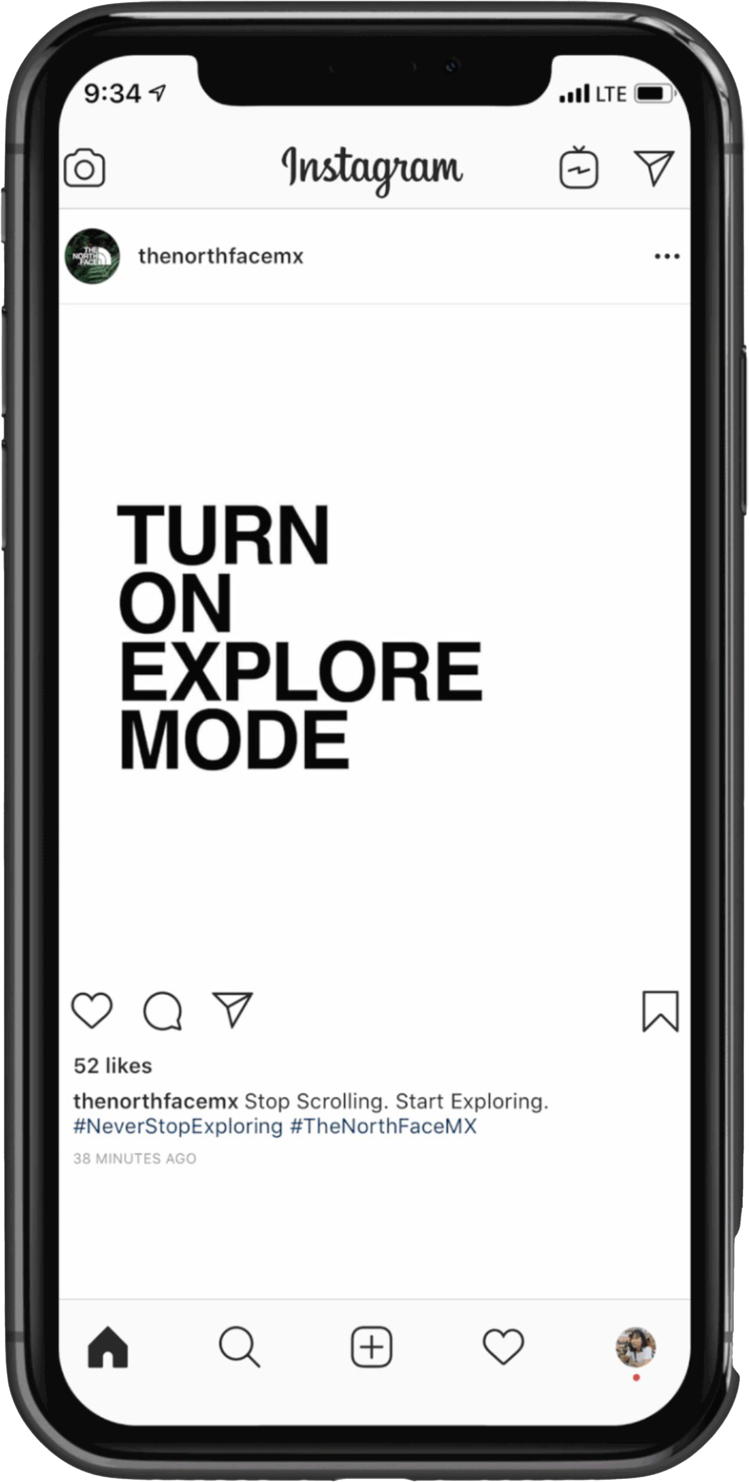
NORTH FACE: EXPLORE MODE
The North Face ran a social media and event-based campaign to encourage you to disconnect and experience the real world.
KEY ELEMENTS
Strong brand tie-in
Scalable approach
Tangible benefit for the consumer
WATCH OUTS
Can be expensive, so needs to have established consumer benefit and longevity
28

Slide 29
HOW CAN YOU DO THIS?
Understand the channels that are going to have the most impact for consumers
Take inspiration from digital and marketing innovation stories
Think about how this could be an extension to the brand

Slide 30
THANK YOU

